Slide 1


Delaware Student Success Collaborative Working Group
March 16, 2021

Slide 2

Housekeeping
Please remember to mute your phone.
  We will also manually mute participants, until the question and answer period.
  Please leave your microphones muted, if you are not speaking.
When speaking, let others know that you are finished by saying one of these sign-offs: “That’s all.” “I’m done.” “Thank you.” , so that everyone knows you have finished your comments.
Please refrain from sharing your video.
If you have questions during the webinar please enter them in the chat box (please find chat box at the bottom of your screen).
The webinar will be recorded and posted on our website.
delawarestudentsuccess.org

Slide 3
Today’s Agenda
Review/Preview of the DE Student Success Collaborative
Refresh on National Postsecondary Strategy Institute Model
Advancing Opportunities for Students through the PSAP
Using Data in Practice
Group Share Out & Reflections
delawarestudentsuccess.org

Slide 4
Review/Preview of the DE Student Success Collaborative

Slide 5
Project Goal
Delaware students should enter 12th grade with an informed career and educational goal. Students will require the academic and technical knowledge necessary to be successful as they pursue these goals beyond high school. Innovation Districts/Charters will serve as a model for how to achieve this for every student.
delawarestudentsuccess.org

Slide 6

Objectives
Disrupt the current assumptions about preparation for college and career that result in inequitable access to the knowledge and skills necessary for students to effectively define and pursue their career and post-secondary education goals.
Establish a diverse group of stakeholders to engage in a learning community with a focus on self-reflection, strategic innovation and scaling best practices that provide every student with the opportunity to explore potential career paths and develop the knowledge and skills to attain the education necessary to pursue their identified career interests.
delawarestudentsuccess.org

Slide 7

Key Deliverables
To ensure the mission is fulfilled, the Collaborative will:
Identify, integrate and evaluate the necessary evidence-based practices, policies and supports through the Innovation Districts/Charters for the purpose of preparing to scale best-in-class model statewide
Provide professional development and coaching to support Collaborative Working Group members with integration of the necessary practices, policies and supports to fulfill the mission
Provide evidence-based student supports throughout Innovation Districts/Charters
delawarestudentsuccess.org

Slide 8
Honoring our Commitment
Each member signed a Commitment Form as part of joining the group. It can be found in our Google Folder for your reference.
delawarestudentsuccess.org

Slide 9
Questions to Consider
What structures/supports/resources need to be in place for an initiative to be successful in your school/district/organization?
If you could wave your magic wand and stop doing something, what would it be?
When you consider your 12th grade students and post-secondary outcome data, what changes do you want to see?
What are the barriers to starting new programs?
What are the barriers to ending ineffective programs?
Are you using your current resources in the most effective way possible?
What legacy programs/policies/fund allocations keep you from moving forward?
delawarestudentsuccess.org

Slide 10
Data to Guide the Work
Located in eSchool:
8th grade math course enrollment by course type
9th grade math course enrollment by course type
Sent by email every two weeks from DHEO:
FAFSA completion (not available by student group)
Located in Delaware Student Success Report:
College Remediation rates
Located in Delaware School Report Card www.reportcard.doe.k12.de.us
ELA proficiency 5th, 8th and 11th grades
Math proficiency 5th, 8th and 11th grades
On track attendance
CER enrollment
CTE pathway enrollment
4-year grad rate
College Ready
Career Ready
delawarestudentsuccess.org

Slide 11

Components of the Collaborative
Collaborative Meetings
Regular meetings to learn and share together
Equity Project
Building approaches to engage students and families
Partnerships
Connecting students to experiences
NPSI Coaching
Support from NPSI as you work on your PSAP and implement strategies
With Creative Reaction Lab
Junior Achievement
Stand By Me
College Tours
delawarestudentsuccess.org

Slide 12
Refresh on National Postsecondary Strategy Institute Model

Slide 13
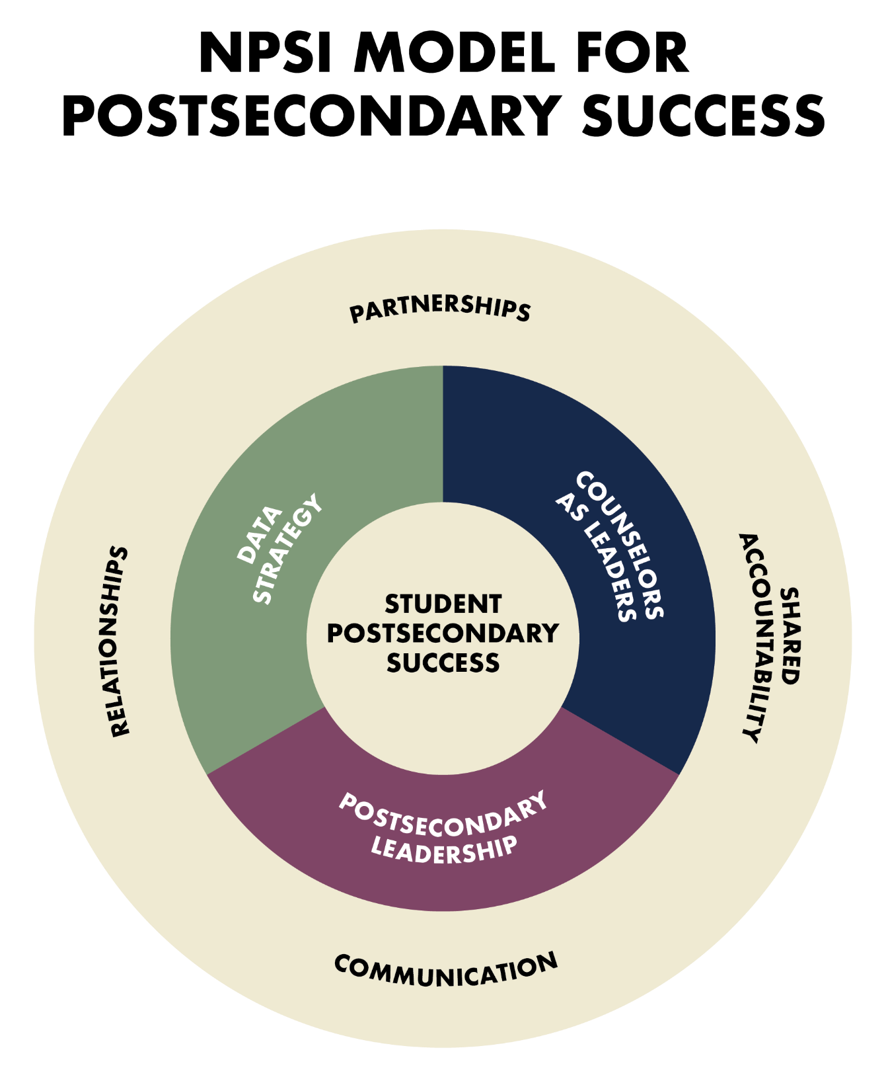

Notes:
NPSI core model and how it connects to equity

Slide 14
Believe → An Equity Driver
All students should be given the experiences, resources, and supports to reach for a credential beyond a high school diploma.
Believe is a way of thinking.
Beliefs are ideas that are learned and can be shared across groups of people.
Beliefs drive behaviors to ensure all students obtain a credential beyond a high school diploma.
NPSI BELIEVES IN EDUCATIONAL EQUITY

Slide 15
Equity Enabling Factors of the NPSI Model
THE WHO | THE HOW
Leadership | Equity reflects lived and felt experiences in decision-making processes. Acknowledge marginalized students.
Data Strategy | Equity is measurable. Commit to monitoring equity data.
School Counseling | Counselors positively affect the culture within their schools. Engage school counselors to implement data informed programs to support academic learning, address social-emotional needs and support college and career aspirations.
Notes:
We know two things about equity. First, it is measurable. Second, it is both a felt sense and lived experience. Therefore, instructional leaders must not only track metrics on equity issues in their schools, they must also use social-emotional learning to positively affect the culture within their schools. Beyond supporting instructional efficacy, we believe that the central focus of school leaders is to address issues of equity in a way that produces systemic shifts.
However, leaders are often left with little time to reflect on how their identity and experiences shape their approach to issues of equity. Without that awareness, leaders are constantly in a reactive state and are unable to understand how their biases affect their responses. As leaders, we can't disrupt inequities if we don't understand our relationship to them. We developed a five-step process to empower and support leaders as they take their self-reflective journey toward equity-centered leadership.

Slide 16
Advancing Opportunities for Students through the PSAP

Slide 17
Data-Informed Collaboration Points
ALL STUDENTS COLLEGE READY
ALL STUDENTS CAREER READY

Slide 18
Every Student College and Career Ready
Delaware Success Collaborative Goal
How Will We Achieve This Goal?
Reviewing Data
Capturing Best Practices
Supporting Your Plans

Slide 19
Postsecondary Advisory Plan
6 Collaborative Action Areas
Every student college and career ready
Overall progress
Targeted student supports
Vertical Alignment
Strengthening Supports

Slide 20
Share Point 1
Measuring Overall Progress
9th Grade on Track
12th Grade on Track
High School Graduation
College Persistence
Notes:
The number of 9th grade students on track should mirror the graduation rate.
PAY ATTENTION
How many do you loose?
When do you loose them?
Why?

Slide 21
Poll Question – Current Practice
I know the percentage of 9th grade students who are on track to graduate.
Yes
No

Slide 22
Share Point 2
Targeted Student Supports
What sub-group populations indicate a need to have targeted supports?
What disaggregated data was used to identify target groups?
What supports are currently in place?
What additional supports are needed?

Slide 23
Poll Question – Current Practice
I use disaggregated data on AP, Dual Enrollment, Assessments, Work-Based Learning, Multi-Literacy Certificate, and Industry Recognized Credential to target sub-groups needing intervention support.
Yes
No

Slide 24
Share Point 3
Vertical Alignment
What practices are in place for grade 8-9 transition?
What practices are in place for grade 12 to postsecondary transition?

Slide 25
Poll Question – Current Practice
I meet with middle schools and higher education institutions to align and review transition practices.
Yes
No

Slide 26
Share Point 4
Strengthening Supports
CCR Support Calendar to Include:
List of student supports
List of family supports
Internal support offerings
External support offerings
How often are supports being offered
List targeted supports for students, families, teachers aligned to accelerating postsecondary opportunities.

Slide 27
Poll Question – Current Practice
My organization has a calendar of student and family supports that support CCR readiness.
Yes
No

Slide 28
Share Point 5
Continuous Supports
Professional Development
Texas On Course
NPSI Coaching Calls
Other

Slide 29
Poll Question – Current Practice
How many times over the past year have you attended PD related to the Collaborative’s student outcome measures?
One Time
Two Times
Three Times
More Than 4 Times

Slide 30
Using Data in Practice

Slide 31
Start with a Theory of Action
District Mission
Strategic Priorities
Student Outcome Gaps
Beliefs
Delaware Student Success Collaborative Goals
Notes:
31

Slide 32
Example Theory of Action
Students enroll in college
What does this look like for the Collaborative?
District Goal
Seniors complete the FAFSA before enrolling in college
Intermediate Measures
Seniors complete FAFSA early in school year
Notes:
32

Slide 33
Using Data in Practice
Big Picture Connected Daily Practice
ELA proficiency 5th, 8th and 11th grades
Math proficiency 5th, 8th and 11th grades
On track attendance
8th grade math course enrollment by course type
9th grade math course enrollment by course type
CER enrollment
CTE pathway enrollment
FAFSA completion (not available by student group)
4-year grad rate
College Ready
Career Ready
College Remediation rates
What actions are you taking to improve these outcomes?

Slide 34
Break Out Activity
Go to a breakout room with your organization
Pick 1 or 2 student outcome data points for discussion
Discuss:
  How are our students doing?
  What are we doing to improve students’ outcomes in these areas?
  What is a new strategy we can try?
Report out: 2 minutes per organization

Slide 35
Data Points for Your Discussion
School Districts
Refer to report from University of Delaware discussed in coaching calls last week
Higher Education
Focus on FAFSA Completion
Partner Organizations
Focus on FAFSA Completion
OR Organizational data for student outcomes
Completed FAFSA in DE | Did Complete FAFSA
Year | # Students | % Students
2020-21 | 3,906 | 40.2%
2019-20 | 4,262 | 45.4%
2018-19 | 4,178 | 45.2%
2017-18 | 4,226 | 45.9%

Slide 36
Break Out Activity
Discuss:
  How are our students doing?
  What are we doing to improve students’ outcomes in these areas?
  What is a new strategy we can try?
Report out: 2 minutes per organization

Slide 37
Group Share Out and Reflections

Slide 38
Next Steps

